Slide 1
Project 1: S&P 500 Analysis

Slide 2
Agenda
Purpose of the Project
Resources & Software
Data Manipulation and Calculations
Data Visualizations
Conclusions

Slide 3
Purpose
Analyzed the annual performance of S&P 500, their sectors and the largest company per sector over a fixed span of time and found correlation with three market indicators.
These indicators are :
CBOE Volatility Index (VIX)
Price of Gold (oz.)
10 Year Treasury Rate Change

Slide 4
Resources & Software
Yahoo Finance
Price information for S&P 500 Index
Price information for 9 of the 11 sectors within the S&P 500 Index
Price information of 9 top performing companies within each sector
Real Estate & Communications Sector created after 1999
Software
Python Jupyter Notebook
Pandas
Matplotlib
Notes:
9 of 11 RE and Communications came out post 1990

Slide 5
Data Manipulation and Calculations
Import CSV files
Left merge based on date (month)
Filtered data based on date using Datetime function
Percent Change Year-Over-Year calculation
Plotting and visualizing

Slide 6
Data Visualizations for S&P 500
Annual performance 1990 -2020
Market indicators
Industry performance
Individual top performing companies

Slide 7
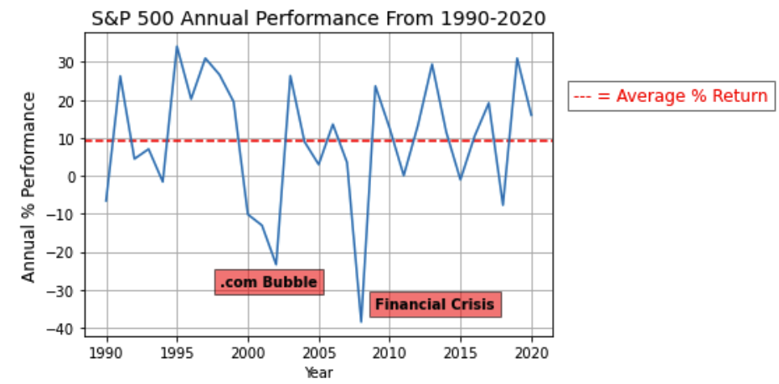
S&P 500 Annual Performance (1990-2020)
Two major dops
Dot.com bubble & Financial Crisis 2008
Roughly a 10% average return per year over this time period

Slide 8
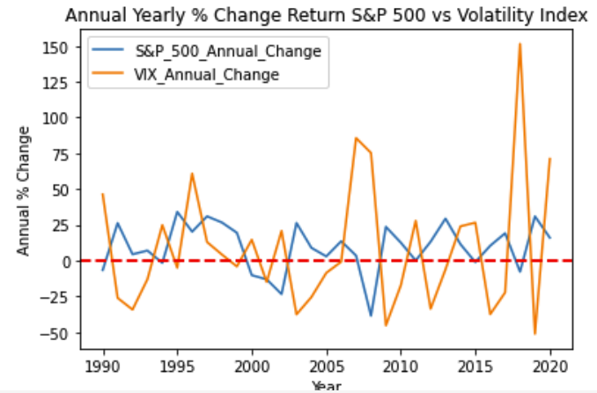
S&P 500 vs. CBOE Volatility Index (VIX)
The level volatility did not have a direct correlation to the performance of the S&P 500
R-Value: 0.2157
Notes:
R-Value:

Slide 9
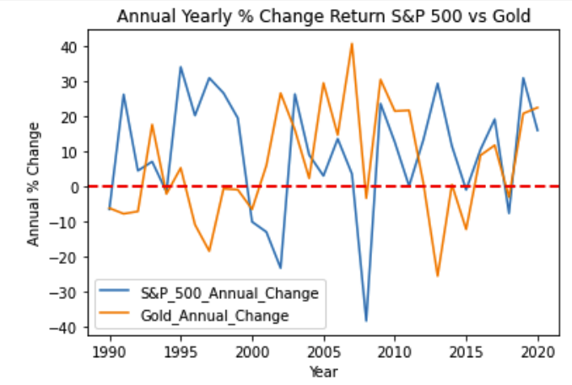
S&P 500 vs. Price of Gold (oz.)
The value of gold did not have a direct correlation to the performance of the S&P 500
R-Value: 0.004

Slide 10
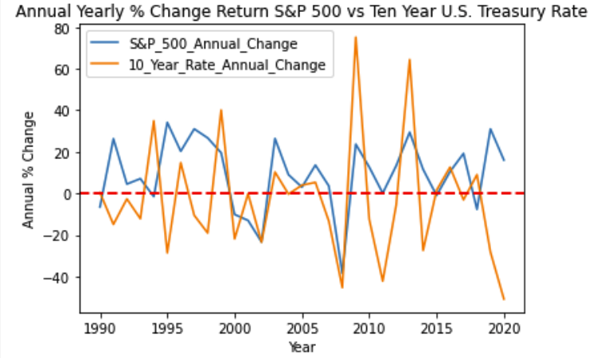
S&P 500 vs. 10 Year Treasury Rate Change
The 10 Year Treasury Rate did not have a direct correlation to the performance of the S&P 500
R-Value: 0.07

Slide 11
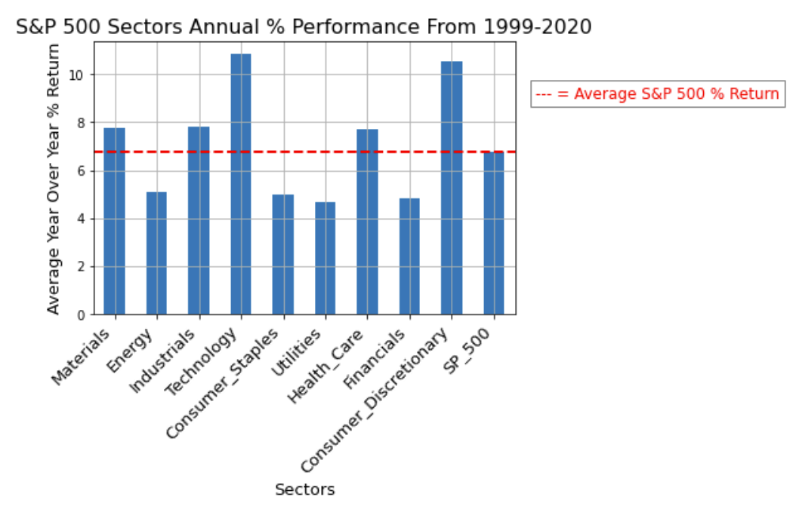
S&P 500 - Sector Performance
5 industries outperform the S&P 500 include Materials, Industrials, Technology, Healthcare, and Consumer Discretionary
S&P return was 6.71%
1999 – 2020

Slide 12
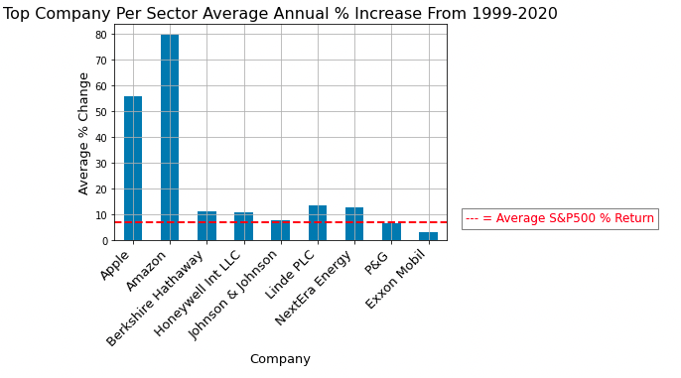
S&P 500 - Largest Companies from each Sector
Analysis of the largest companies per S&P 500 sector
Apple and Amazon two highest performing within their respective sector

Slide 13
Implications
S&P 500 had roughly 10% return during the 30 year period
(include level of correlation against indicators)
Top performing industries
Top performing companies

Slide 14
Analysis of S&P 500 data from 1999 – 2020
Analysis of 9 industries with the S&P 500
There were 11 industries total, but analyzed 9
Analysis of top 9 companies within those industries

